Slide 1

GLA ASSISTANT
YOUR PERSONAL VIRTUAL ASSISTANT

Slide 2
Outline
Introduction
GLA Assistant
Application areas
Working
Requirements
Technology used
Potential areas
Motive
Integration

Slide 3
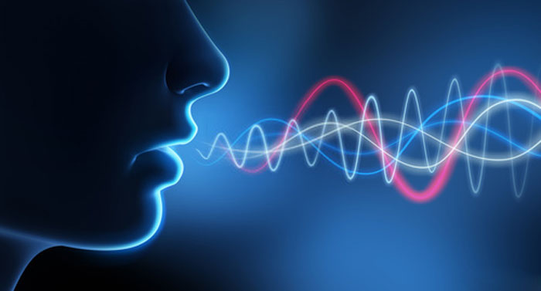
GLA Assistant ?
GLA Assistant is a virtual personal assistant.
Which can engage in two-way conversation.
It is able to search the information using INTERNET and Dataset on the user’s device and show information to the user.

Slide 4
Application areas:
University
Infrastructure
Academic section
Admission cell
Fee Structure
Software Products
Google dictation used in Microsoft products
Voice co

Slide 5
Working
Usually, People interact with GLA Assistant through their natural voice. It similarly works as Alexa (Amazon).
It works on the principle Voice recognition. Voice assistants are used in help and service phone lines, smartphones and other places to assist users with tasks using voice commands.
Notes:
Voice assistants are programs on digital devices that listen and respond to verbal commands. A user can say, “What’s the weather?” and the voice assistant will answer with the weather report for that day and location.

Slide 6
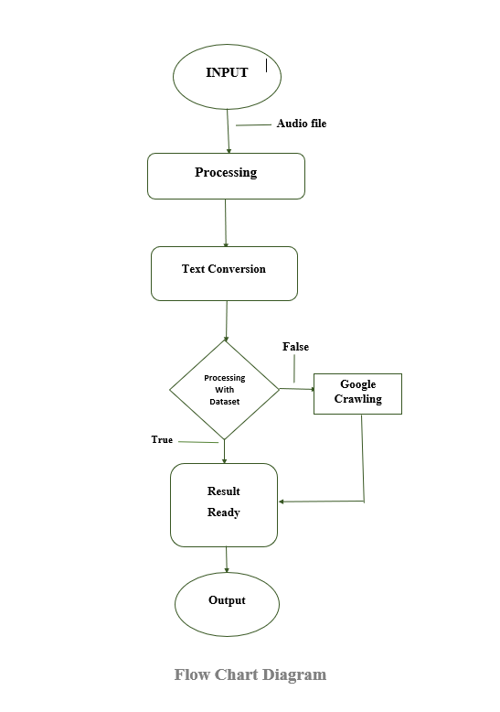

Slide 7
Voice assistants are programs on digital devices that listen and respond to verbal commands. A user can say, “What’s the weather?” and the voice assistant will answer with the weather report for that day and location.
Once in the database, your request is compared to other requests. It’s split into separate commands your voice assistant can understand. The database then sends these commands back to the voice assistant. Once it receives the commands, the voice assistant knows what to do next. The device might ask a question to make sure it understands what you want. If it thinks it understands, the voice assistant will carry out the task you asked for in its database and finally it will respond to the query being asked.

Slide 8
Requirements
Hardware
Hardware:
1TB HDD
8 GB RAM
Intel i5 8th Generation processor
Microphone
Speaker
Software
Python IDLE
Microsoft Visual Studio 14.0

Slide 9
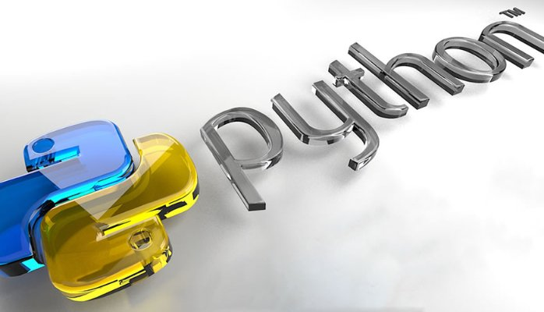
Technology used :
Python 3.6.0 ( 32-bit )

Slide 10
Libraries used:
nltk
pyaudio
pyttsx3
speechRecognition
wolframalpha
pywin32

Slide 11
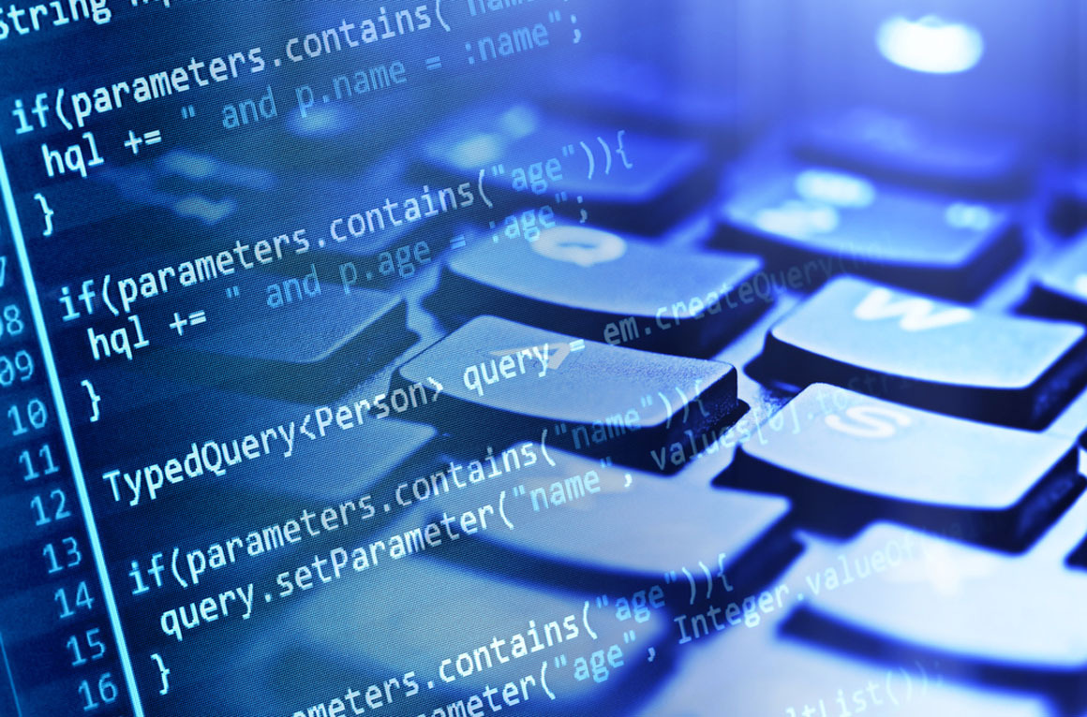
nltk
Nltk stands for natural language toolkit.
Works with human language data.

Slide 12
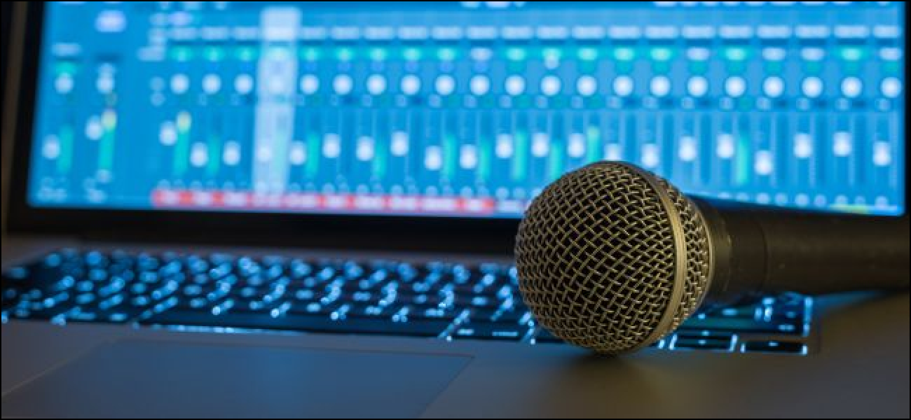
pyaudio
It is a I/O library which deals with Audio.
With PyAudio, you can easily use Python to play and record audio on a variety of platforms, such as Linux, Microsoft Windows etc.

Slide 13
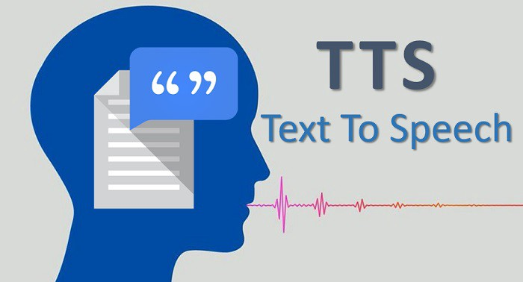
pyttsx3
This lets you synthesize text in to audio you can hear.
Text to speech package.

Slide 14
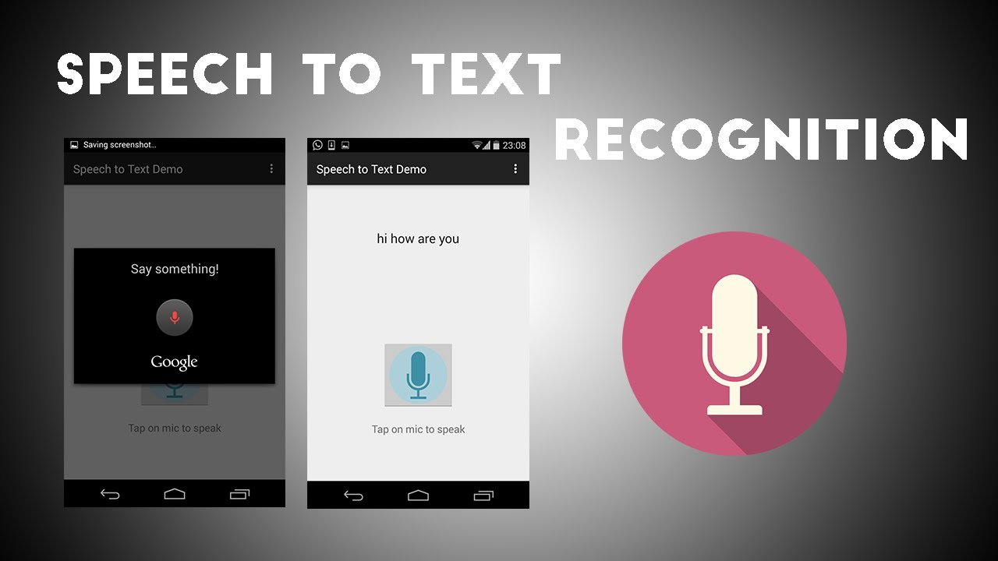
SpeechRecognition
Speech to text package.
Ability of machine or program to identify words and phrases in spoken language and convert them into machine readable form.

Slide 15
Potential areas
Solving Crimes With Voice Recognition
Letting Your Voice Protect Your Bank Account
Buying Products and Services With The Sound of Your Voice

Slide 16
Motive
To easy the task for the user, so that he/she can get the required information about a particular in short span of time.

Slide 17

Alexa (Amazon)

Slide 18
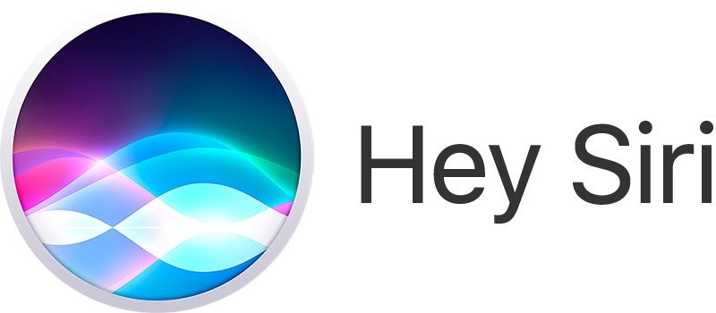
Siri (Apple)

Slide 19
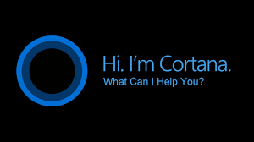
Cortana (windows 10)

Slide 20
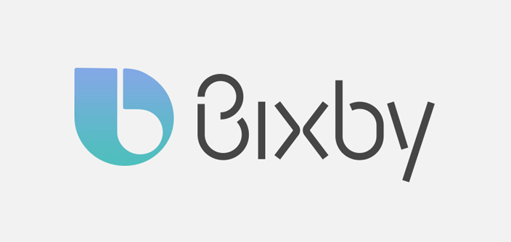
Bixby (Samsung)

Slide 21
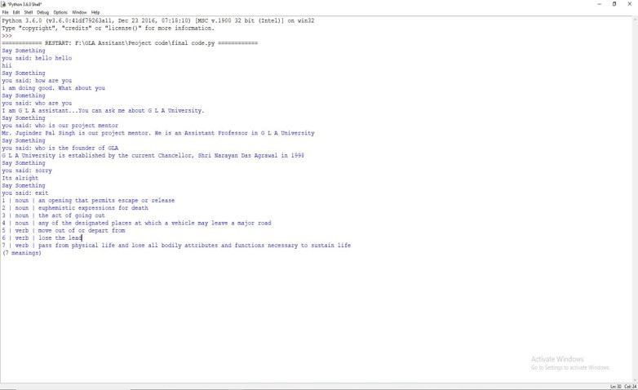
Glance over GLA Assistant

Slide 22
CRAWLING
Crawling is the process which deals with large data sets where you develop your crawlers or bots which crawls to the deepest of the webpage.
Crawler
A Web crawler, sometimes called a spider or spiderbot and often shortened to crawler, is an Internet bot that systematically browses the World Wide Web, typically for the purpose of Web indexing (web spidering).
Scrapping
Data Scrapping on the other hand, refers to retrieving information from any source (not necessarily the web).

Slide 23
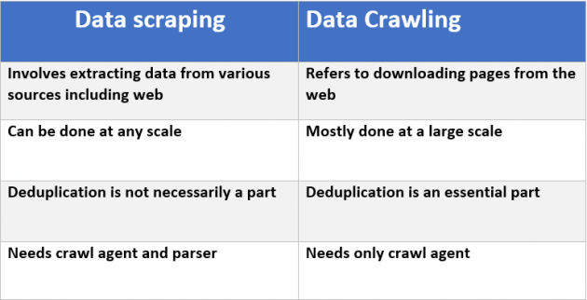
Some differences…

Slide 24
Types of crawling
Site crawls
Site crawls are an attempt to crawl an entire site at one time, starting with the home page.
Page crawls
Page crawls, which are the attempt by a crawler to crawl a single page or blog post.

Slide 25
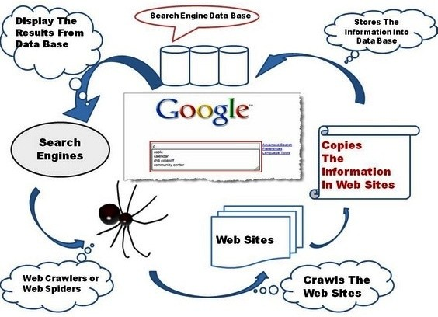
Architecture of Crawler

Slide 26
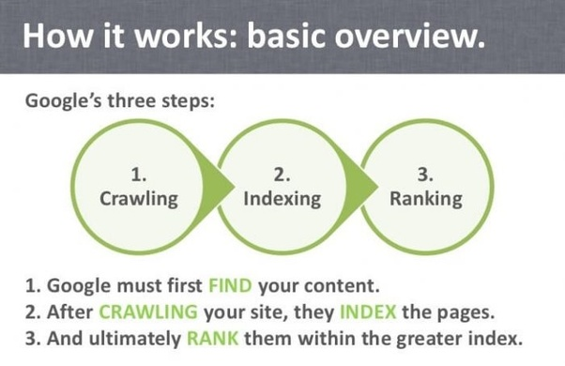
How actually searching takes place

Slide 27
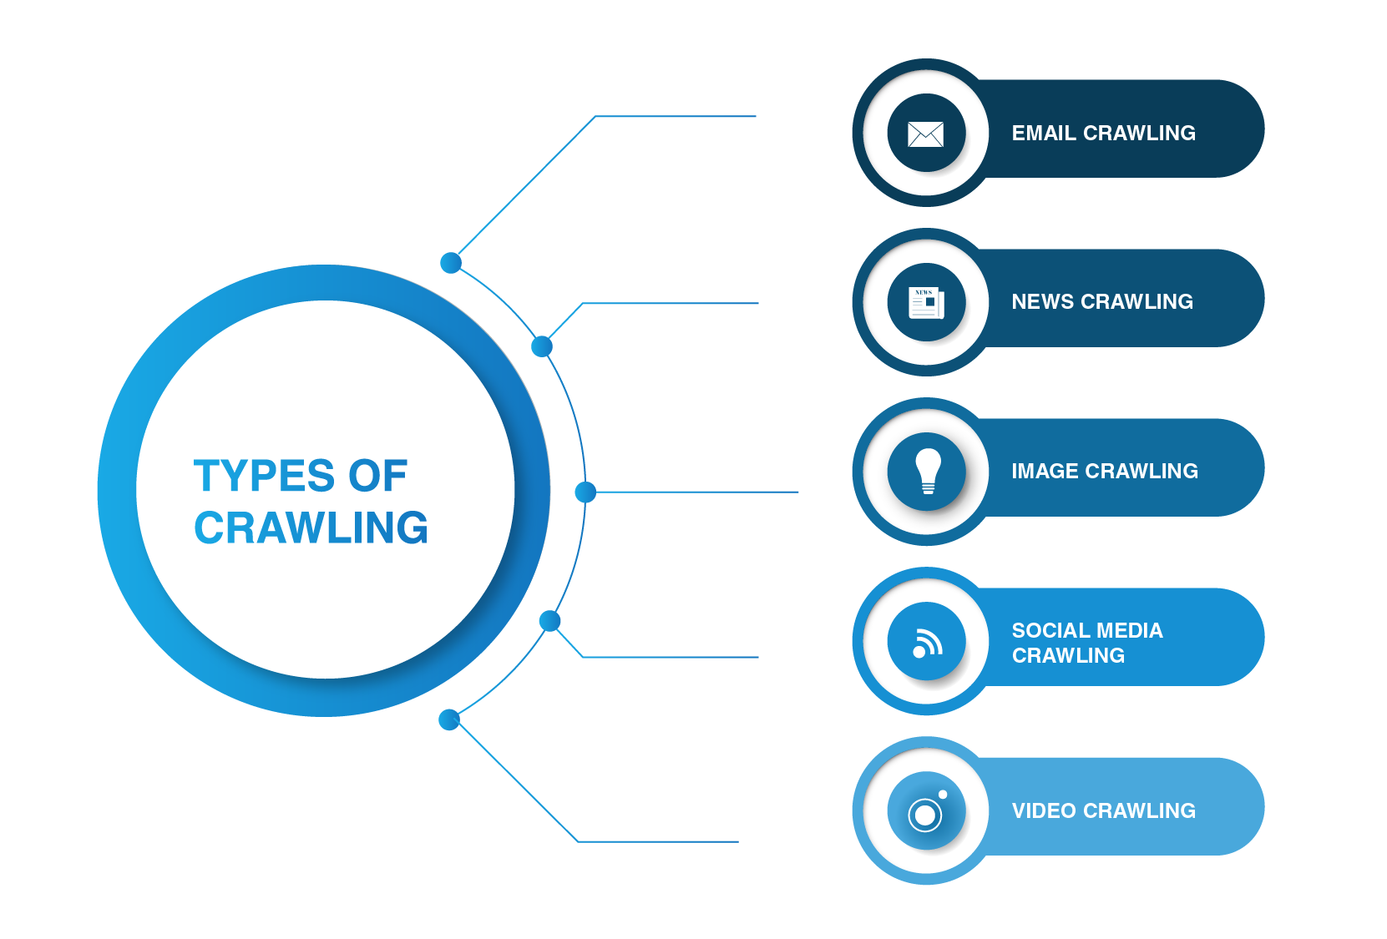

Slide 28

Types of Crawlers/spiderbots
Screaming Frog
Screaming Frog is a website crawler that enables you to crawl the URLs.

Slide 29

DeepCrawl
DeepCrawl is a cloud-based tool that helps you to read and crawl your website content and also monitors technical issues.

Slide 30

Apify
Apipy crawls lists of URLs and automates workflows and extract data using Javascript.

Slide 31
Indexing
Indexing is the process done when the data from a crawl is processed and placed in database.

Slide 32
Ranking
Once a keyword is entered into a search box, search engines will check for pages within their index that are a closest match.
Provide the pieces of content that will best answer a searcher's query, which means that results are ordered by most relevant to least relevant.
Different ranking algorithms are working at the backend.

Slide 33
Libraries used:
Beautiful soup 4
Requests
Urllib 2 || Selenium

Slide 34
Beautiful soup 4
Beautiful Soup is a Python library for pulling data out of HTML and XML files.
It makes it easy to scrape information from web pages.

Slide 35
Requests
Requests is an Apache2 Licensed HTTP library, written in Python. It is designed to be used by humans to interact with the language. This means you don’t have to manually add query strings to URLs, or form-encode your POST data.
Handles the HTTP method calls.
HTTP is a set of protocols designed to enable communication between clients and servers.

Slide 36
Urllib 2
urllib is a Python module that can be used for opening URLs.

Slide 37
GLA VOICE ASSISTANT
PROJECT MENTOR:-
DR. ROBIN SINGH BHADORIA
ASSISTANT PROFESSOR
GLA UNIVERSITY, MATHURA
PROJECT DONE BY:-
UJJAWAL TRIPATHI
(2115990021)

Slide 38
Thank You

